Slide 1
PREDICTIVE ANALYSIS: Energy investment portfolio for government of Canada
Mirul Patel (N01489347)

Slide 2
AGENDA
Motivation
Introduction
Overview
Data Description
Table Structure
Analysis

Slide 3
Energy Investment portfolio?
Why?
Government of Canada plans to bring millions of immigrants every year to maple land. And Energy is one of the key factors which will dictate how they successfully do that.
What?
We gather data from previous years and share the findings of the generation, relative consumption, imports and exports on provincial level. To further predict factors like revenue, investment and incentive.
How?
We extract data, clean, transform, load, join and visualize to give prediction.

Slide 4





INTRODUCTION
We have examined Canada’s electricity data in three categories: capacity, generation and exports.

Slide 5
OverVIEW
Canada is a world leader in hydro electricity, which accounts for 59.3% of the country's electricity supply. Other sources include coal, uranium, natural gas, petroleum and non-hydro renewable sources.
In the upcoming years, it is anticipated that factors including population expansion, economic growth, and increased use of electrical equipment and appliances would continue to drive power consumption.
The federal government plays a supporting role by investing research and development of electricity management.

Slide 6
Data description
Source:
For Capacity & Generation
https://open.canada.ca/data/en/dataset/2cdf43fc-d4aa-4604-9f21-29777d955810
For Import/Export
https://open.canada.ca/data/en/dataset/5c358f51-bc8c-4565-854d-9d2e35e6b178
Fields in Data
Electricity Capacity : Region, Source, Capacity value, Unit
Electricity Generation : Region, Source, Generated Value, Unit
Electricity Import/Export : Region, Source, Destination, Activity Value, Price

Slide 7
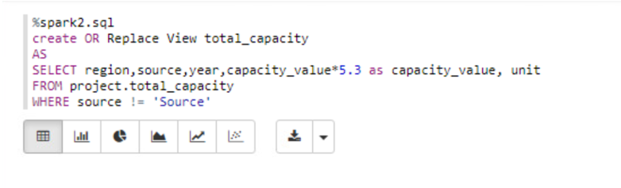
Data transformation
Motivation for doing this transformation was to plot the factors of all the aspects we considered on the same plane. Hence, the normalized data was imminent. We had 3 units of electricity to begin with MW, GWh and MWh.
Further we decided to use GWh unit as standard to be able to capture all the factors visually in a graph plane. So, we convert MWh & MW into GWh.
How we did that?
1 GWh = 1000 MWh
We took 5300 constant hours as standard no of hours of electricity production in an year.
(1/1000)*5300 = 5.3

Slide 8
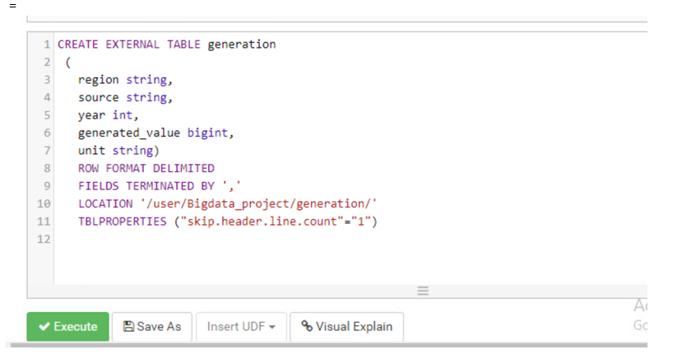
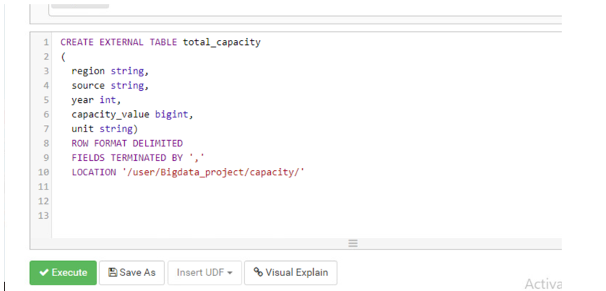
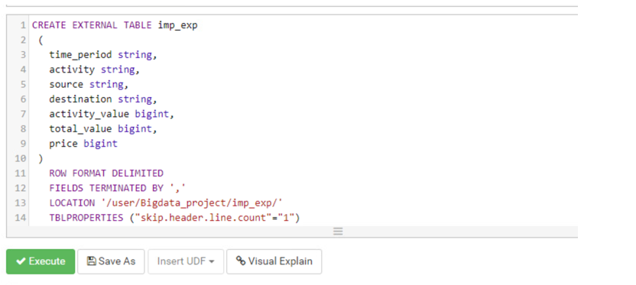
Table Structure

Slide 9
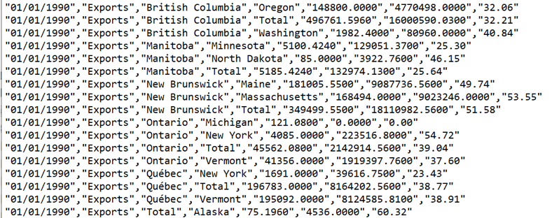
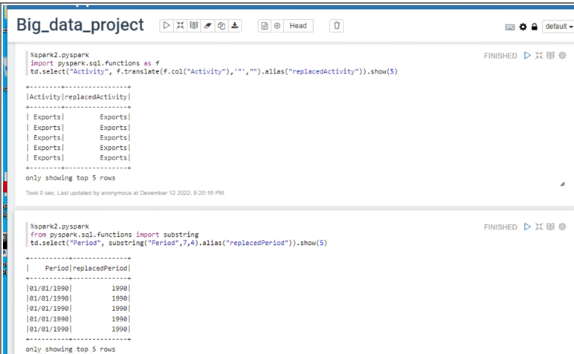
Data Cleaning

Slide 10
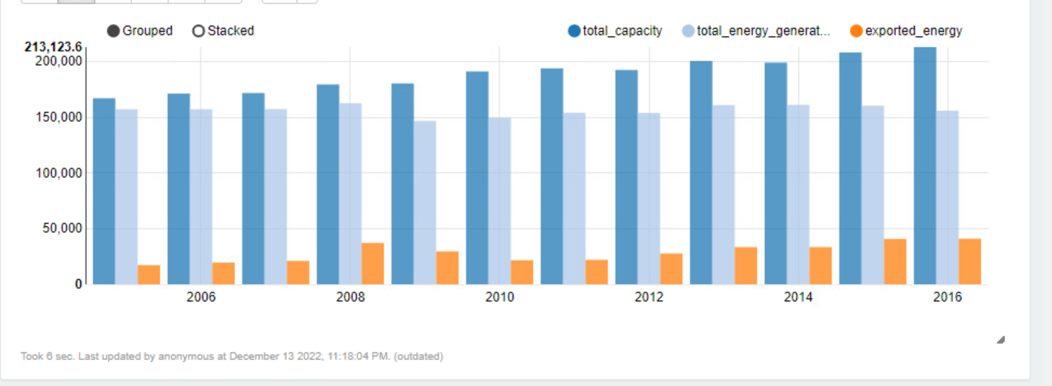
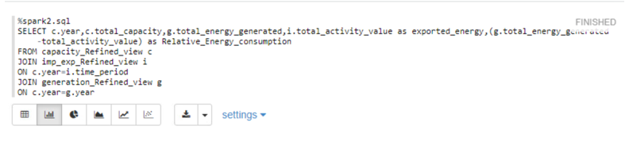
Analysis 1: Ontario

Slide 11
Analysis 1: Ontario
Findings: The general trend for exports was they average increase, while generation remained constant, and capacity climbed steadily i.e. more focus was on increasing the capacity of the province.
Prediction: Ontario can increase revenue by increasing generation solely for the purpose of exports.

Slide 12
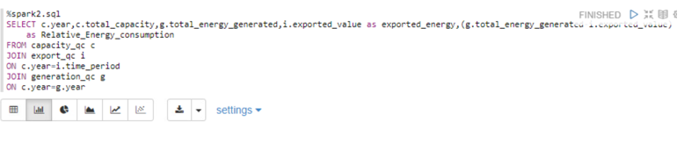
Analysis 1: QUEBEC

Slide 13
Analysis 1: Quebec
Findings:
Capacity constantly increased which was replicated in generation, Unlike trends in exports show that the provincial government was inconsistent.
Prediction:
Investments in increasing capacity i.e. improving infrastructure to boost the good generation, which can then produce more energy for exports for province to increase revenue.

Slide 14
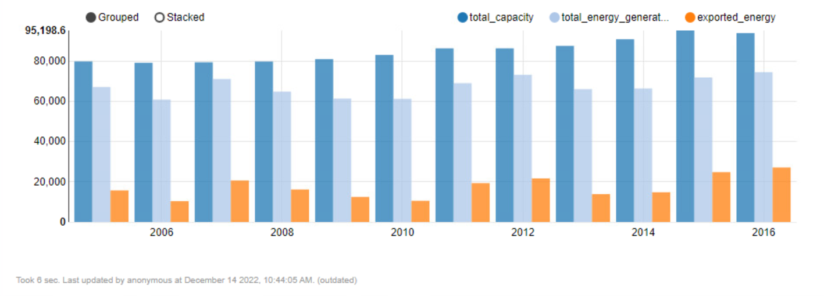
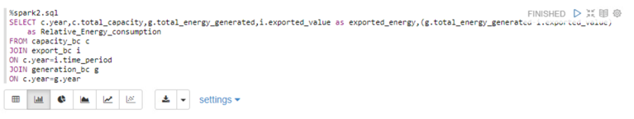
Analysis 1: BRITISH COLUMBIA

Slide 15
Analysis 1: BRITISH COLUMBIA
Findings:
The capacity increased gradually over the years, and interestingly generation was sinusoidal, which reflected in their exports
Prediction:
They don’t need any investments. In order to increase revenue , provincial government should focus on exports, they must consistently increase generation.

Slide 16
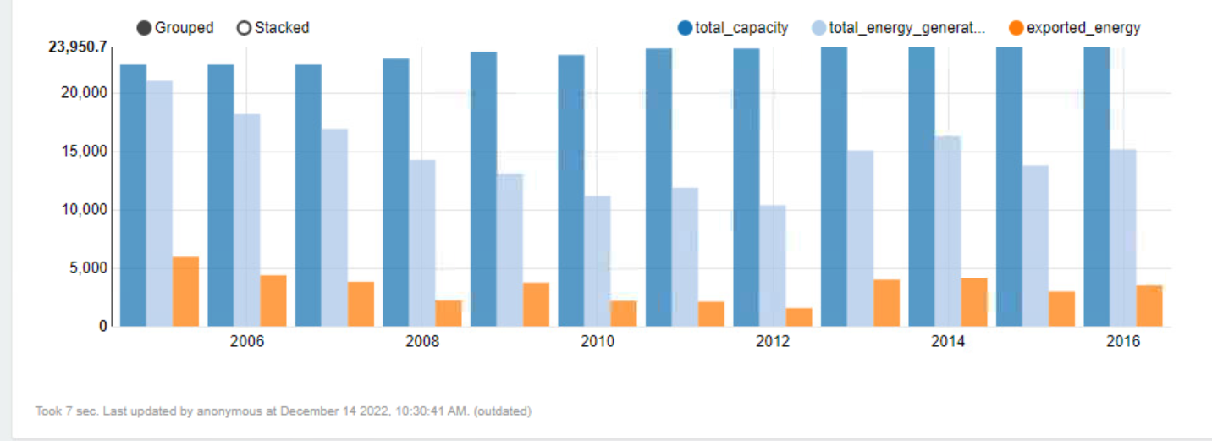
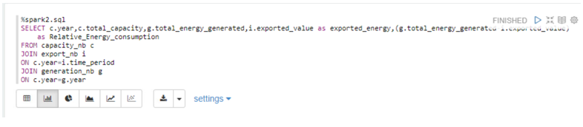
Analysis 1: NEW brunswick

Slide 17
Analysis 1: NEW brunswick
Findings:
Capacity increased slightly over the years. As you can clearly see power generation is erratic which reflect that exports fluctuated.
Prediction:
NB should focus on consistent power generation so that exports can be increased constantly to boost revenue. So, the NB government should focus on generation infrastructure.

Slide 18
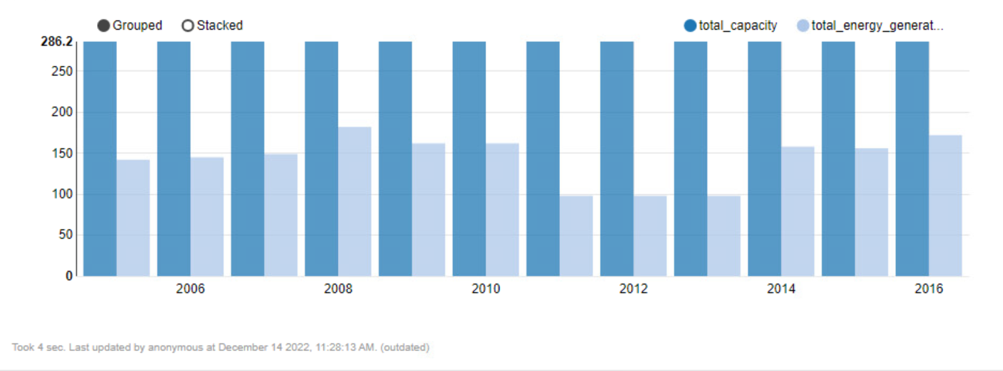
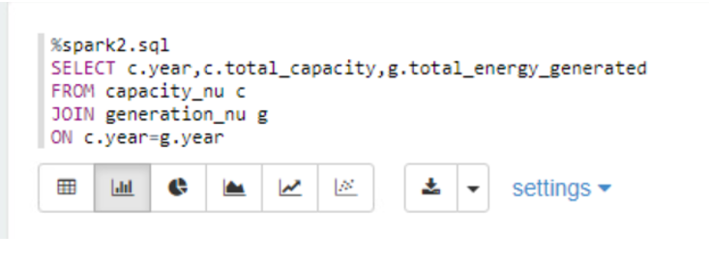
Analysis 1: Nunavut

Slide 19
Analysis 1: NUnavut
Findings:
Capacity is almost similar over the years, energy generation increased over the years as well. But, Zero exports.
Prediction:
NU government should start new income stream by exporting electricity, which will give the state more pedigree in bank to build the state.

Slide 20
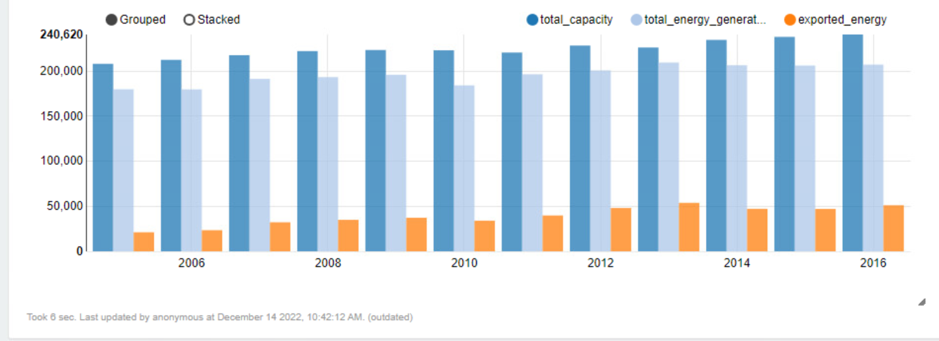
Analysis 1`
Ontario
Quebec
Nunavut
British Columbia
New Brunswick

Slide 21
Analysis 1`: federal investment
Findings:
Quebec needs investment in capacity generation, BC and Ontario are doing fine and they don’t need support. Nunavut has zero exports.
Prediction:
Federal government needs to invest in Quebec for building capacity, NB will require support from them in increasing generation as knowledge sharing. ON and QC on the other hand are the stable provinces which would only require federal support. While Federal Government needs to bring incentives in NU for beginning a new revenue stream and invest in transmission infrastructure from NB.

Slide 22
Analysis 2
Ontario
Quebec
Nunavut
British Columbia
New Brunswick

Slide 23
Analysis 2: Emergency situation(Fiona)
Findings:
In an emergency, Ontario and Quebec have the capability to export electricity. Because they have high percentage of margin between total capacity and total energy generation.
Prediction:
Federal government should invest in transmission infrastructure throughout the country!

Slide 24
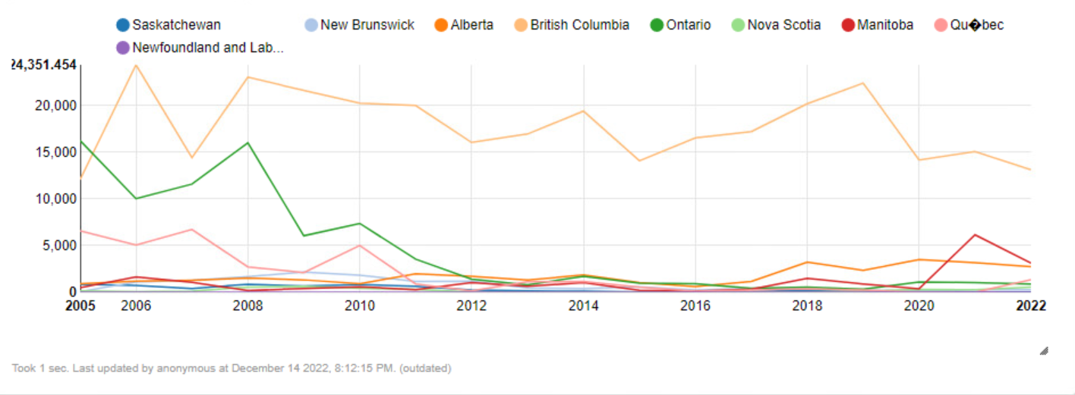
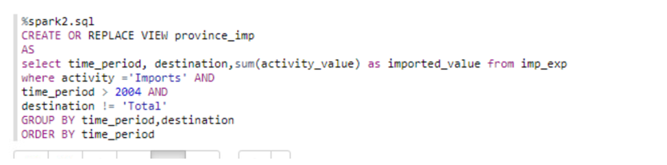
Analysis 3

Slide 25
Analysis 3
Findings:
As you can see in the picture above, BC typically imports more electricity than any other province in Canada. We can also see how much energy BC can produce.
From above diagram, we can measure that, BC can generate more electricity as they have enough plan capacity to generate and by doing that province can save that import cost.
Prediction:
To conclude that, provincial government of BC should focus more on generation and work gradually to increase plan capacity.

Slide 26
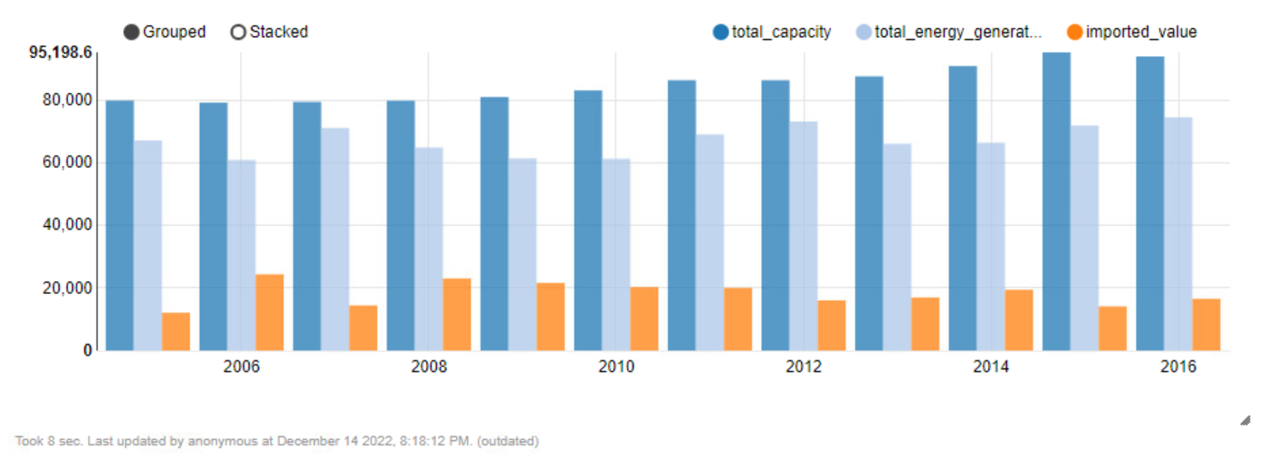
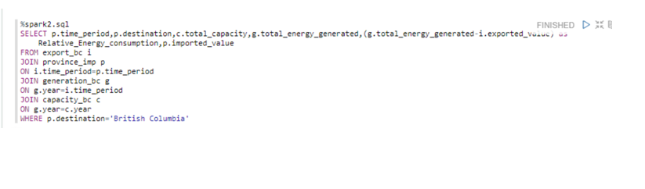
Analysis 3
British Columbia

Slide 27
THANK YOU

